Slide 1
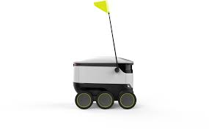
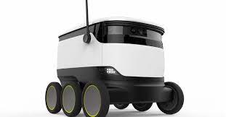
20CDT23 – Design Thinking
FOOD DELIVERY BY USING ROBOTS (TEAM 7)

Slide 2
TEAM 7
21CDR008 ---- CHAMMISH DHYANN KESHAV G
21CDR018 ---- KARTHIKA M
21CDR025 ---- MOHAMED AJMAL M
21CDR028 ---- NANDITA S
21CDR040 ---- SAM WILLSON S
21CDR053 ---- TAMIL ARASAN U

Slide 3
List of Templates
T1: SCOPES
T2: STEEP Trend Analysis
T3: STEEP Analysis Matrix
T4: STEEP Analysis Prioritization
T5: Strategic Priorities Matrix
T6: Synthesis
T7: Activity System Mapping
T8: Key Components of Activity System
T09: Stakeholder Mapping Matrix
T10: Stakeholder Links & Relationship Mapping
T11: Stakeholder Priority Mapping Matrix
T12: Stakeholder Analysis & Engagement Strategy
T13: Project Brief and Opportunity Framing
T14: Project Brief and Reframing Project Challenges
T15: Reframing the Opportunities

Slide 4
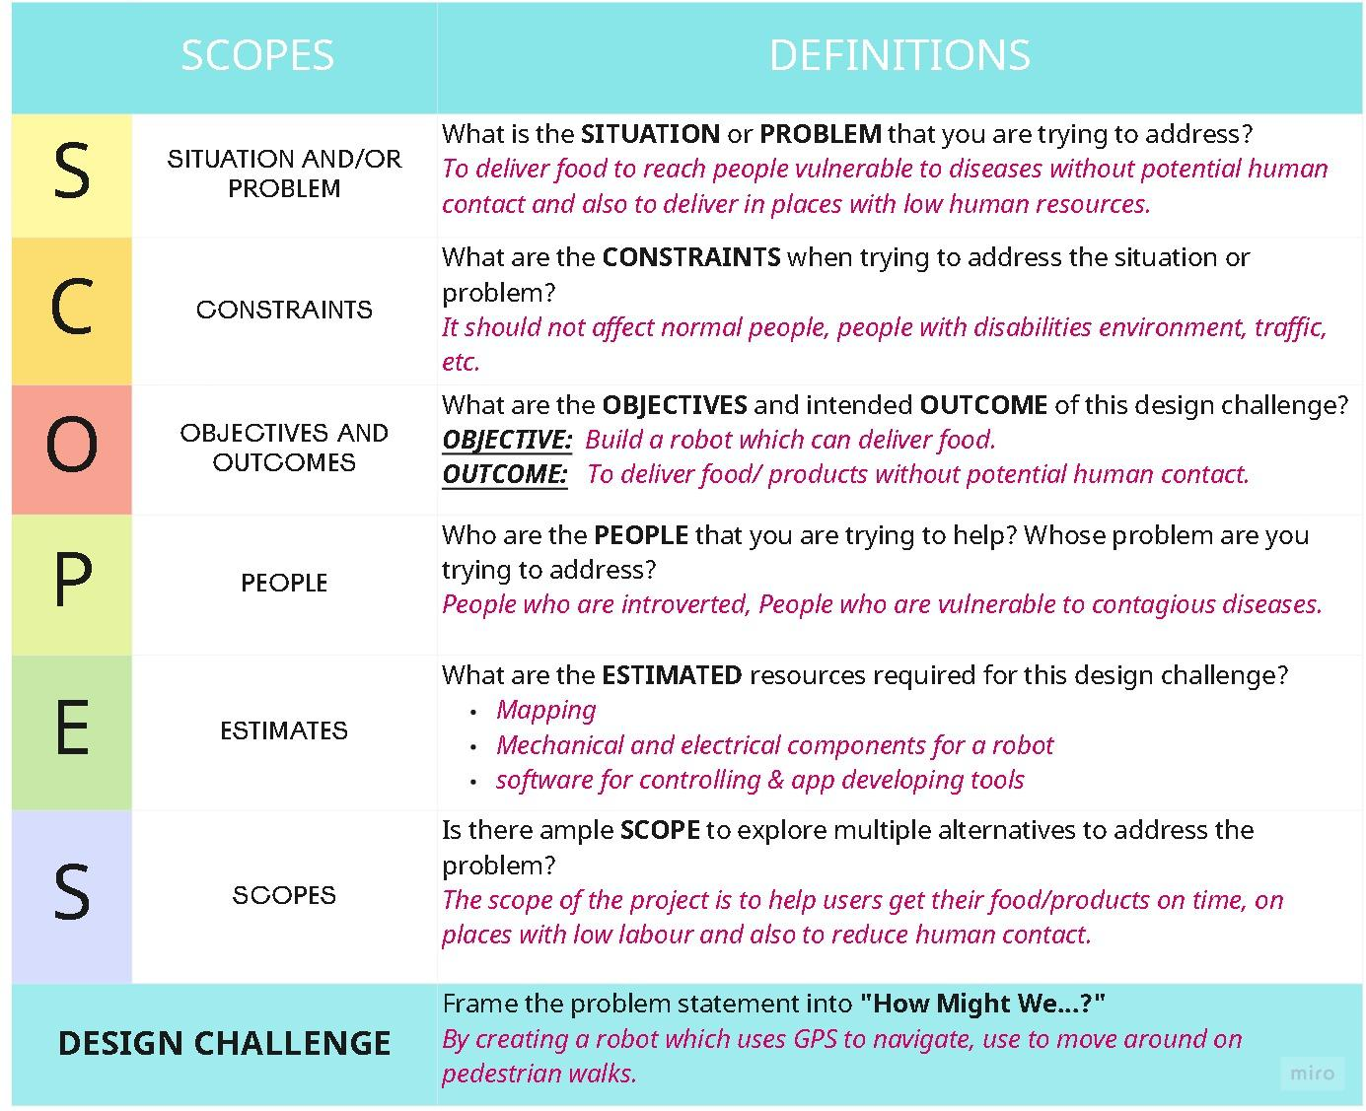
T1: SCOPES TOOL

Slide 5
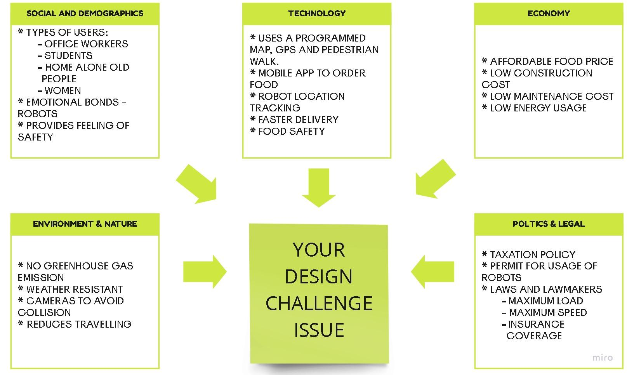
T2: STEEP TRENDS ANALYSIS

Slide 6
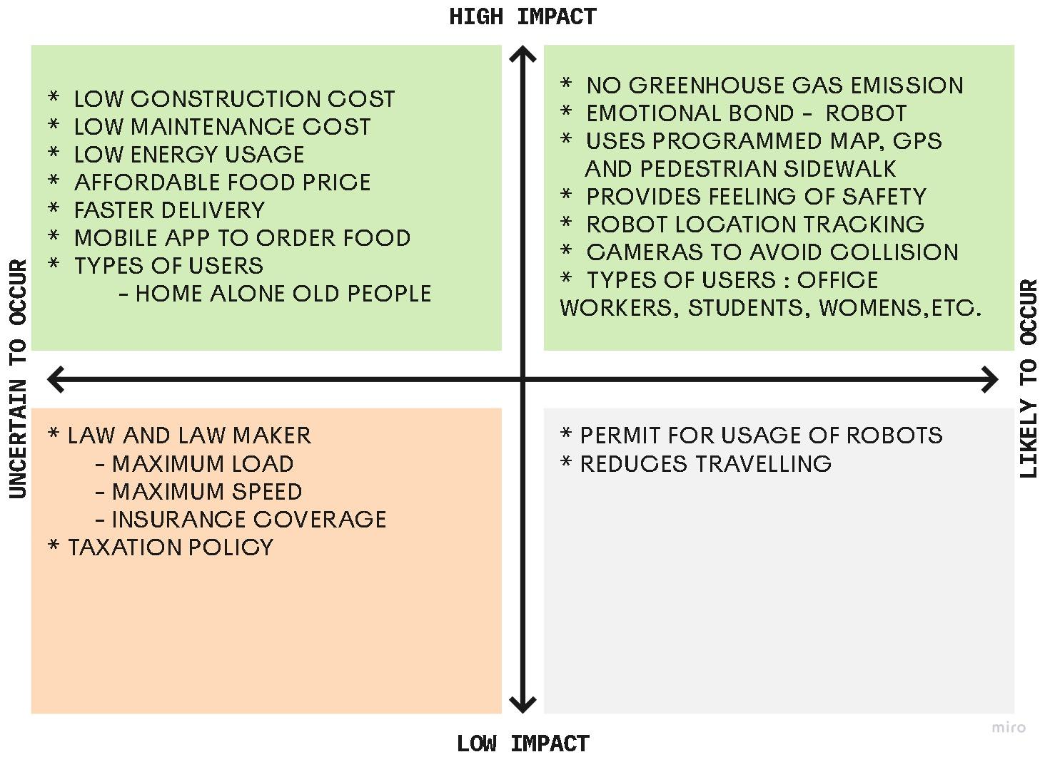
T3: STEEP Analysis Matrix

Slide 7
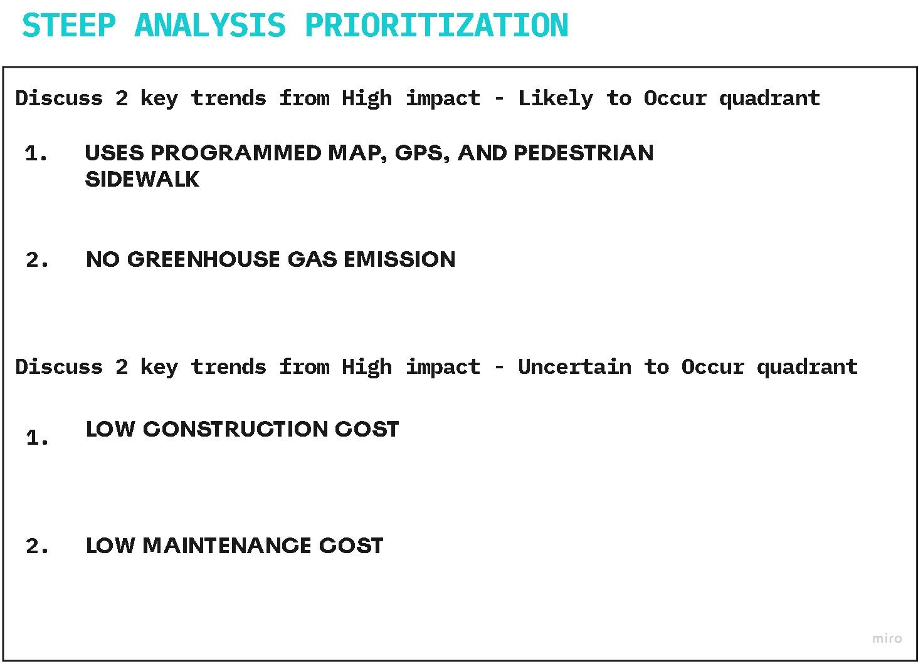
T4: TEEP Analysis Prioritization

Slide 8
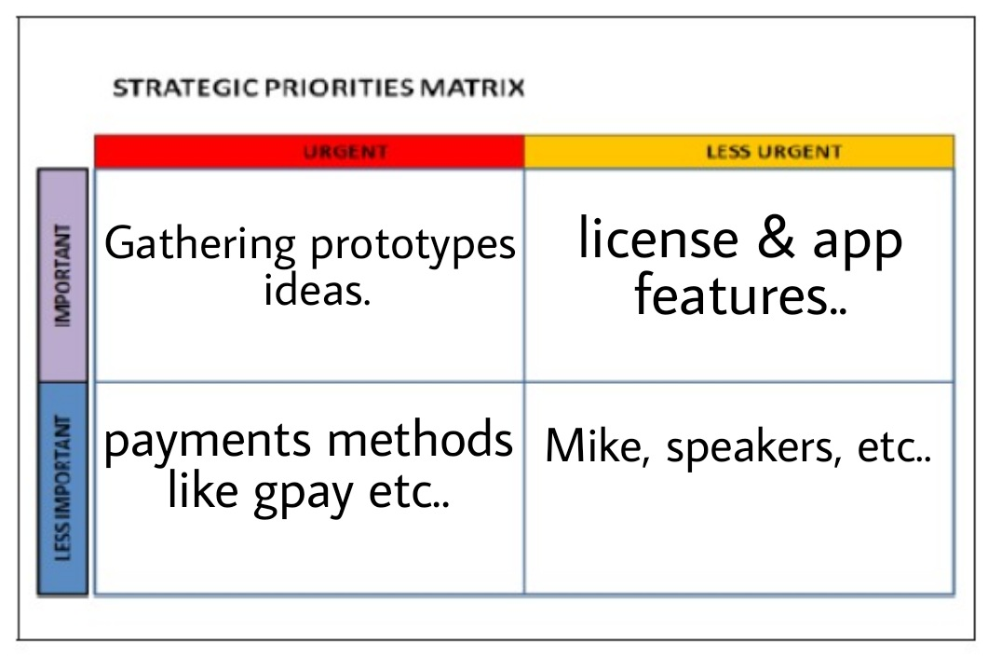
T5 – Strategic Priorities Matrix

Slide 9
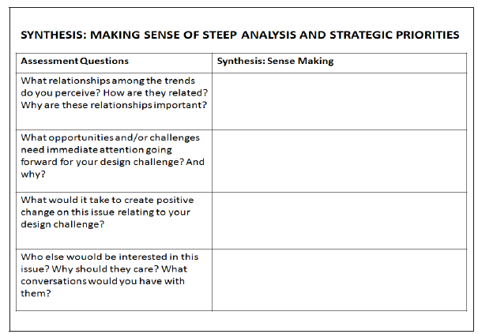
T6 : Synthesis (Sense Making)
It is between the customers and the agencies...
If any customer is unfulfilled by this technology, it will
Be a biggest Drawback. So it is essential to satisfies
the requirements of the customer for the success
Unexpected lockdown because it really helps in that situation and our idea definitely get the attention of people.
We can minimize the crime happened by the delivery boys through the robots
Introvert people and who are busy with their work and don't have to spend much time on ordering and receiving food.
Notes:
Unexpected lockdown because it really helps in that situation and our idea definitely get the attention of people.

Slide 10
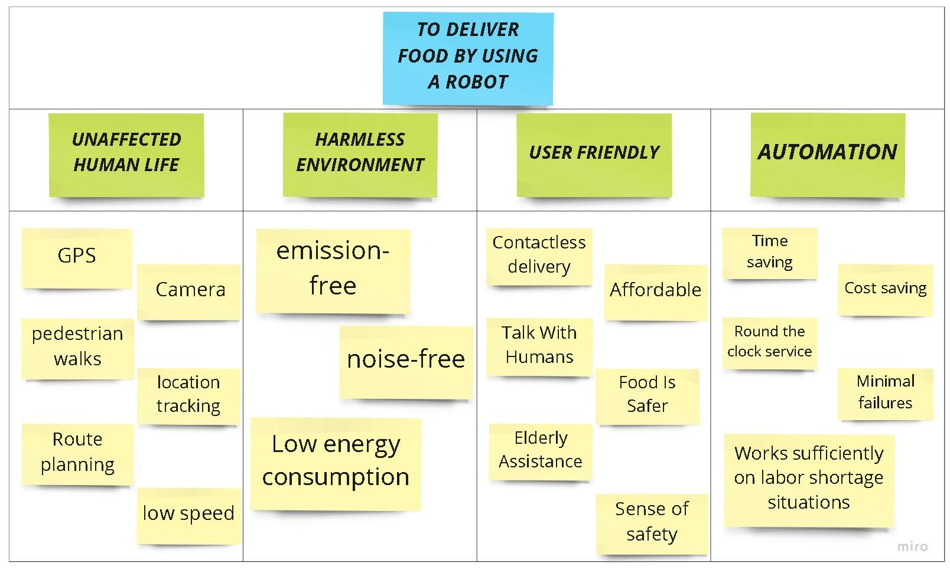
T7 – Activity System Mapping

Slide 11
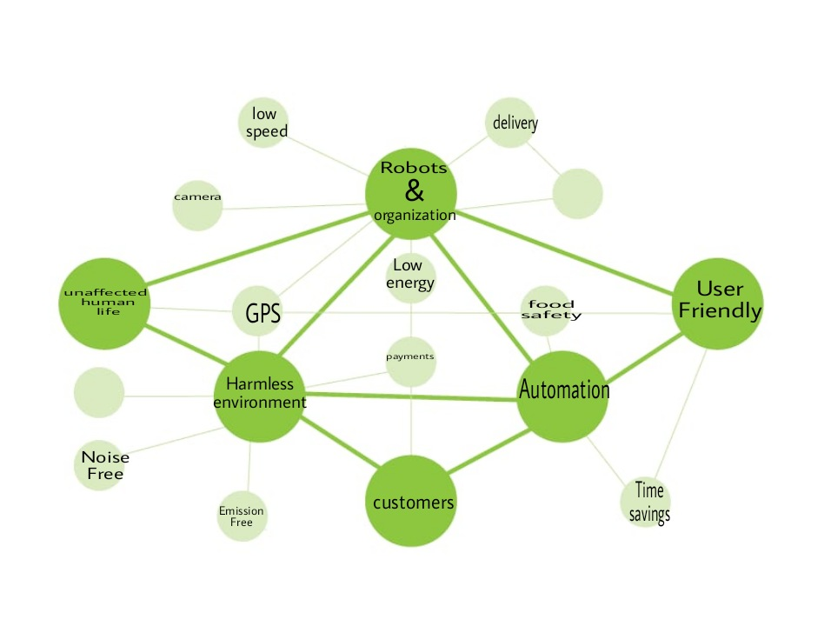
T8 – Key Components of Activity System

Slide 12
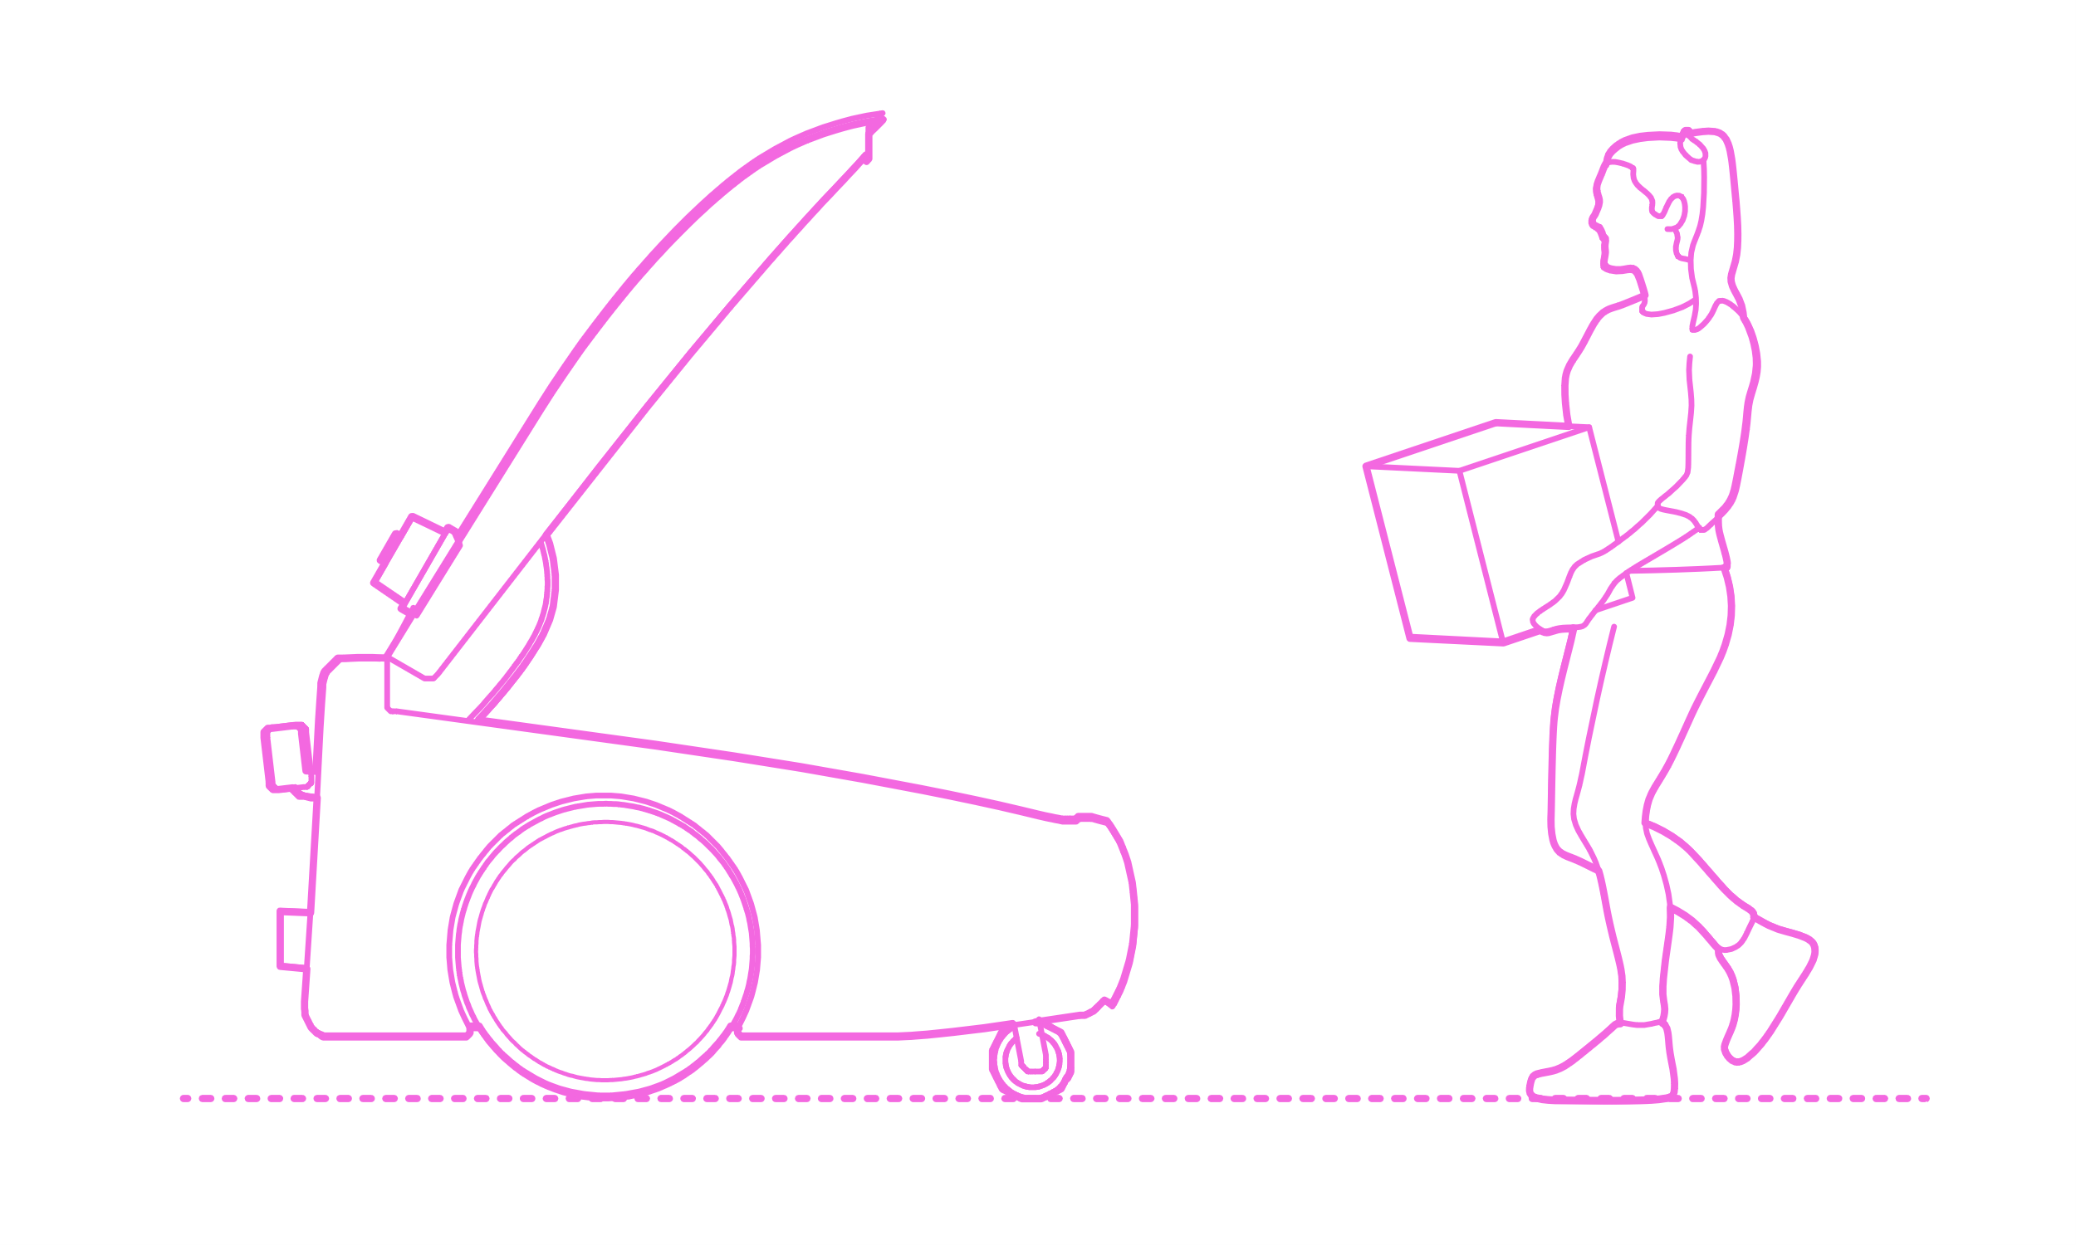
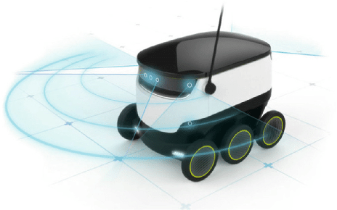
T9: Stakeholder Mapping Matrix
HIGH INTEREST
HIGH INTEREST / LOW INFLUENCE
HIGH INTEREST / HIGH INFLUENCE
SCHOOL STUDENTS
BUSIEST PEOPLE
FOODIES
OFFICE WORKERS
LOW INFLUENCE
EMPLOYEES
OWNERS
LOW INTEREST / LOW INFLUENCE
LOW INTEREST /HIGH INFLUENCE
HIGH INFLUENCE
CONSERVATIVE PEOPLE
SHARE HOLDERS
NOVICE USERS
INVESTORS
OLD PEOPLE
GOVERNMENT
LOW INTEREST

Slide 13
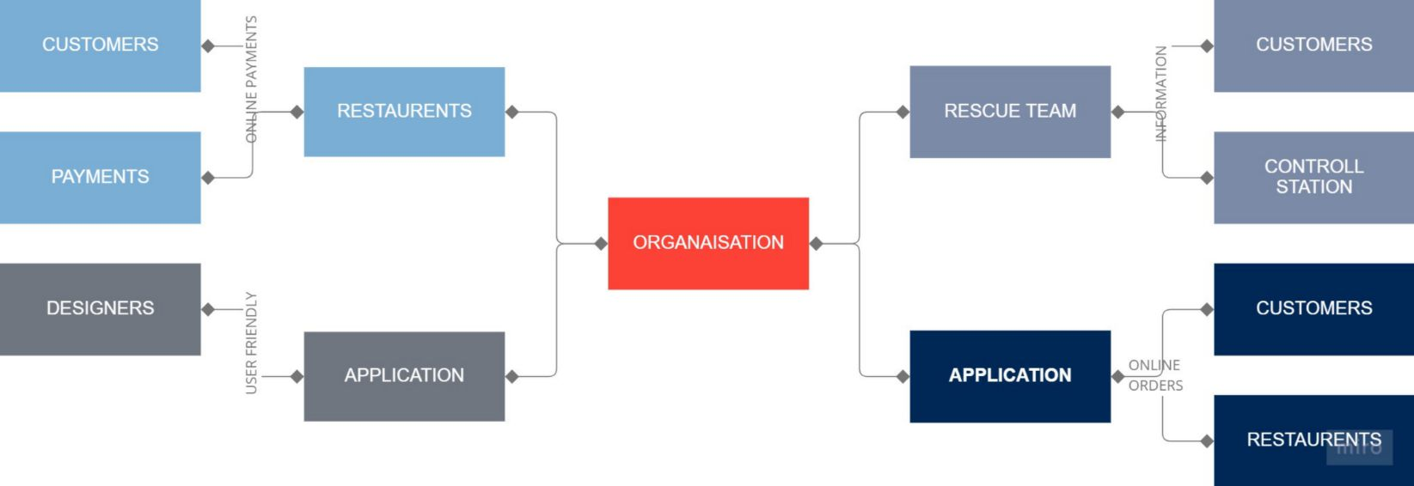
T10: Stakeholder Links & Relationship Mapping

Slide 14
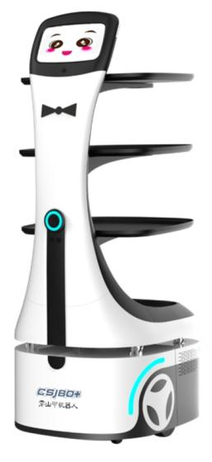
T11 : STAKEHOLDER PRIORITY MAPPING MATRIX
HIGH INTEREST
HIGH INTEREST / LOW INFLUENCE
HIGH INTEREST / HIGH INFLUENCE
KEEP SATISFIED
ENGAGE CLOSELY
Foodies
School students
Employees
Office workers
Busiest people
Owners
OFFICE WORKERS
EMPLYEES
LOW INFLUENCE
HIGH INFLUENCE
LOW INTEREST / LOW INFLUENCE
LOW INTEREST / HIGH INFLUENCE
MONITOR (MINIMUM EFFORT)
KEEP SATISFIED
Government
Investors
Share holders
Conservative people
Novice users
Old people
LOW INTEREST / LOW INFLUENCE
LOW INTEREST

Slide 15
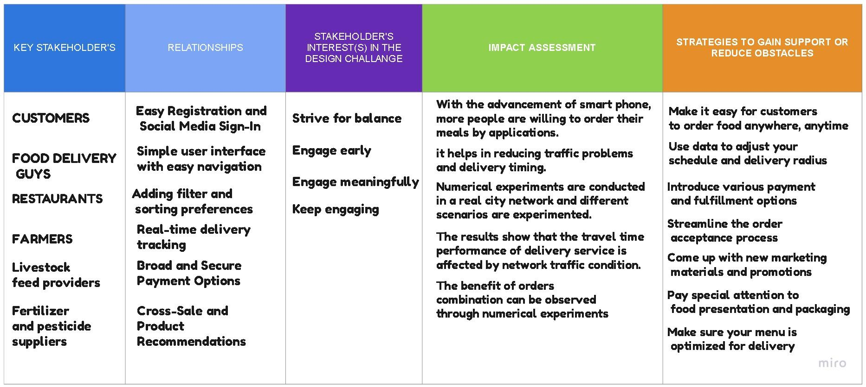
T12: Stakeholder Analysis & Engagement Strategy

Slide 16
T13: Project Brief and Opportunity Framing

Slide 17
CHALLENGE OR PROBLEM DEFINITION
ORGANIZATION NAME :
OWN
PROJECT SPONSOR
ADDRESS & CONTACT :
CONTACT PERSON(S) :
PROJECT TITLE
FOOD DELIVERY ROBOT
DESIGN CHALLENGE
TO MAKE A FOOD DELIVERY ROBOT TO
DELIVERY FOOD
WHAT ARE THE ISSUES AND OPPORTUNITIES THAT INSPIRED
THIS DESIGN CHALLENGE?
DESIGN CHALLENGE
CONTEXT & BACKGROUND INFO
FUEL WASTAGE
HIGH POWER CONSUMPTION
TO BE COST EFFECTIVE

Slide 18
GOALS AND OBJECTIVE OF THIS DESIGN CHALLENGE
TO DELIVERY QUALITY FOOD IN LESS TIME
TO MAKE PEOPLE COMFORTABLE
TO DELIVERY FOOD NOT ONLY IN CITIES BUT ALSO
TO DELIVER FOOD TO LOCAL AREAS
TARGET USERS OF
THIS DESIGN CHALLENGE
FOR BUSY PEOPLES
FOR OFFICE WORKERS
FOR OLD PEOPLES
FOR COLLEGE STUDENTS AND YOUNG ADULTS
CUSTOMERS
FOOD DELIVERY GUYS
RESTAURANTS
FARMERS
BUTCHERS
OTHER KEY
STAKEHOLDERS

Slide 19
PREVIOUS EFFORTS
TO SOLVE THIS DESIGN CHALLENGE
TRYING TO MAKE SOME PROTOTYPE
WORKING ON SOME IDEAS ABOUT FOOD DELIVERY
USING STICKY NOTES TO TRACK OUR IDEAS
CURRENTLY TRYING TO DEVELOP SOME PROTOTYPES
OF THE ROBOTS
CURRENT ACTIVITY SYSTEM & PROCESS

Slide 20
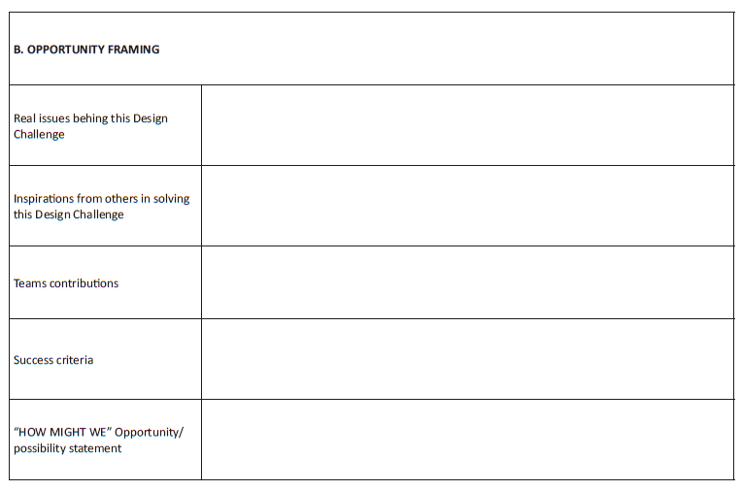
T14: Project Brief and Reframing Project Challenges
Without phone,we can’t unlock the robots.
Food delivery robots size is similar as humans,it can hold only 20 pounds which means approximately 9 kgs.so we can’t order food for any event or function
Food delivery robots are already exists in USA,Russia and some countries makes steps to proceed this.these robots will not affect the activity of normal people and it will reduce the time.
21CDR008-Relationship between agencies and customers ,impact assessment due to this food delivery robot.
21CDR040-identified the problems and required solutions.
21CDR025-Make conversation with the customers and found the problems.
21CDR018-Reframing the projects into how might we..and found the issues behind this design challenge.
21CDR053-Gathered information about the organisation in which the robots works under.
21CDR028-Identity relevant key stakeholders and the stakeholder priority.
Food delivery has made major advancement in the past few years,wito track orders in real time.In this pandemic situation,it will greatly reduces the spreading of diseases..
To approach the restaurants as we need their support to deliver food and customers as they are going to use this app and the robot .
to develop the app user friendly as they can select their favorite food and store it in the wish list.they can cancel the order within 5 minutes if they don’t want and they can track the robot’s live location…
To communicate with customers with their known language using microphones..
To reduce the accident as the robots having cameras.
Notes:
21CDR008-Relationship between agencies and customers ,impact assessment due to this food delivery robot.
21CDR040-identified the problems and required solutions.
21CDR025-Make conversation with the customers and found the problems.
21CDR018-Reframing the projects into how might we..and found the issues behind this design challenge.
21CDR053-Gathered information about the organisation in which the robots works under.
21CDR028-Identity relavent key stakeholders and the stakeholder priority.

Slide 21
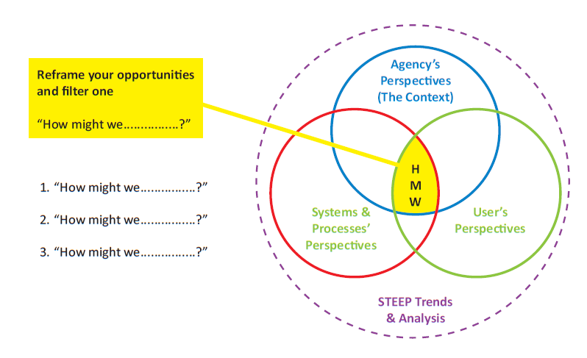

T15: Reframing the Opportunities
1.How might we get the assurance
for the safest delivery?
2.How might we get the support from
all the restaurants and the customers?
3.How might we protect us from
bad weather condition and from burglar?
Notes:
1.How might we get the assurance for the safest delivery?
2.How might we get the support from all the restaurants and the customers?
3.How might we protect us from bad weather condition and from burglar?

